Slide 1
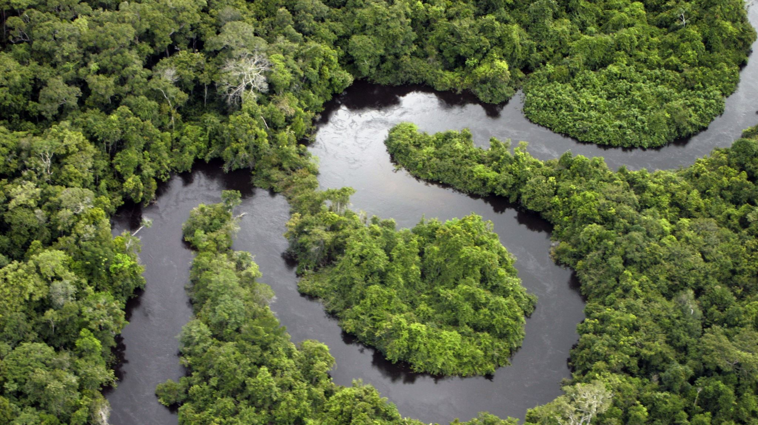
Optimizing Bioeconomy Logistics For The Amazon Region
Progress meeting: 24/05/2024
Group 6: Mamoun, Chenlu, Abdul, Mai, Mia, Bhumin

Slide 2
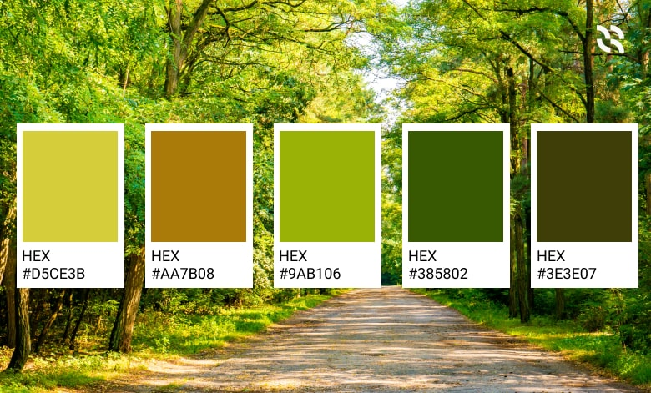
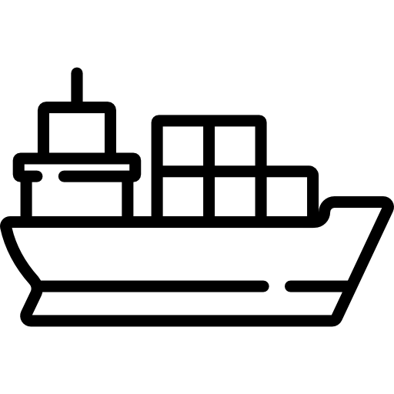




Overview
Transport
(Challenges, Modes, and Technologies)
Scope
2。
4。
1。
3。
5。
Bioeconomy Products
Data Sourcing & Modelling
Clarification Questions
2

Slide 3
Product Specific Information
Bioeconomy Products
 | Characteristics | Environmental impact | Economic impact | Social Impact | Logistical Impact | Resilience and Adaptability
Acai fruit | Region: Mainly in eastern Amazon. Form, Temperature, and Lifespan:‎ Fresh: refrigerate immediately, last ~24 hours post-harvest; Frozen pulp:-18°C or below, last several months to over a year; Powder: below 25°C, last over 1 or 2 years. Harvesting period: August to November (eastern Amazon). | Positive Impact: Minimal deforestation (native palm). Negative Impact: Biodiversity reduction (intensive management). | Market Value: High market demand. Production: Extractivism 13%, Permanent crops 87%. | Community Involvement: High involvement of local and indigenous communities. Labour Conditions: Lack of protective equipments, high accident rates. | Transportation: Efficient river transport but significant losses. Preservation: Need freezing immediately. | Climate Resilience: Well-suited to local floodplain conditions. Legal Regulations: Current legal limit may not be enough.

Slide 4
Bioeconomy Products
Product Specific Information
 | Characteristics | Environmental impact | Economic impact | Social Impact | Logistical Impact | Resilience and Adaptability
Brazil Nuts | Region: Brazilian Amazon, Bolivia, Peru. Form and Lifespan: In-shell nuts (a year or more); Shelled nuts (about 6 months), or processed into oil and butter. Temperature: 5-10°C away from heat and humidity. Harvest Period: October to April. | Positive Impact: Promotes forest conservation and biodiversity. Negative Impact: Land use changes (infrastructure projects) lead to deforestation. | Market Demand: Steady international demand, particularly in health foods. Income Source: Provides significant income for local and indigenous communities. | Community Involvement: Involves traditional knowledge of sustainable harvesting. Marginalized Communities: Promoting social equity, involves ‎around 55,000 extractivists. | Transportation: Remoteness complicates transport; river transport and digital access can improve market linkages. Health and Safety: Aflatoxin contamination is a significant risk, necessitating better quality control. | Climate Resilience: Naturally resilient within diverse forest conditions. Sustainability: Limited by natural growth rates, but it is possible.

Slide 5
Bioeconomy Products
Product Specific Information
 | Characteristics | Environmental impact | Economic impact | Social Impact | Logistical Impact | Resilience and Adaptability
Pirarucu | Region: Throughout the Amazon basin. Rapid growth: 10kg/year, up to 3 meters and 200kg. Form, Shelf Life, and Temperature: Fresh: 2-3 days refrigerated at 0-4°C; Frozen fillets: at least 6 months at -18°C or lower; Dried and salted: several months in cool, dry conditions. | Positive Impact: Protection of lakes benefits other species and ecosystems. Negative Impact: potential water pollution concerns, lack of environmental monitoring (fish farming). | Market Demand: High demand for meat and skin. Income Source: Benefits local fishers and farmers; creates jobs in fishing. Export: Major exporter is Brazil. | Community Involvement: local and indigenous communities.‎ Cultural Importance: Vital part of the culture and diet; ‎promotes social equity.‎ Revenue Distribution: Unequal distribution. | Transport: Efficient transport through rivers and proximity to processing facilities reduce costs. Technology: Digital technology improves market reach and product traceability. | Climate Resilience: Adapted to flooding; scalable with strong market demand and proper management. Regulation: Sustainable catch limit of 30% of the estimated fish stock.

Slide 6
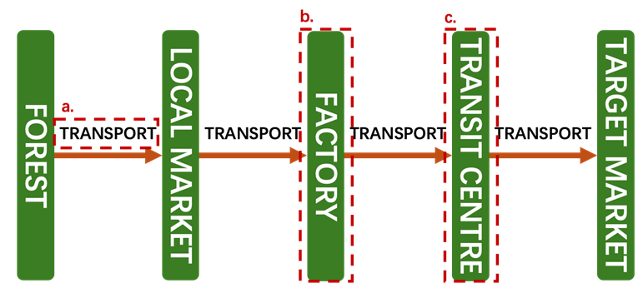
Transport Strategy: Echelons
Main defining stages
Forest waterways:
- Capacity/Time trade off
- Forest environmental impacts
b. Facility location:
- Location selection to save cost
- Pasterisation and refrigeration
c. Regional transportation:
- Containerisation
- Long-distance modal shift

Slide 7

Transport Strategy: Challenges
Geological
Flood plain and Waterlevel fluctuation
Large landmass
Everchanging geological route
Risk of deforestation
Sociological
Conservation area
Lack of skill workers
Limited budget
Safety and Security risk
Regulations
Local reluctance to changes
Technological
3 key aspects required
Communication
Navigation
Power Distribution
Lack of advance resources

Slide 8
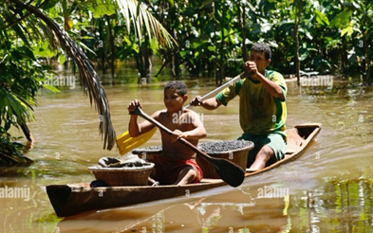
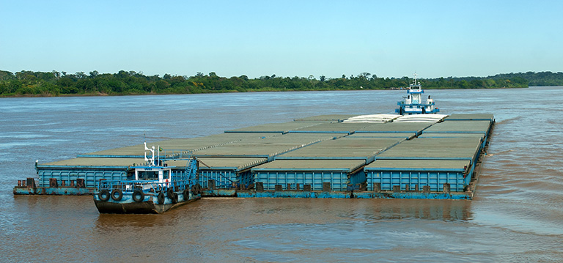
Transport Strategy: Existing modes
Chategorisation by capacity:
Small:
Canoes/Dugout Canoues (Pirogues)
Motorized Canoues (Rabeta)
Medium:
Regional Boats (Barcos Regionais)
Ferries
Speedboats (Lanchas)
Large:
Barges (Tucked or Motorised)
Acai berry collection canoes,
Alamy, 2007
Barge convoy on the Río Madeira,
A.PAES / shutterstock.com

Slide 9
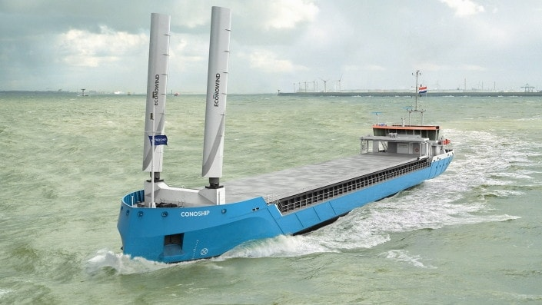
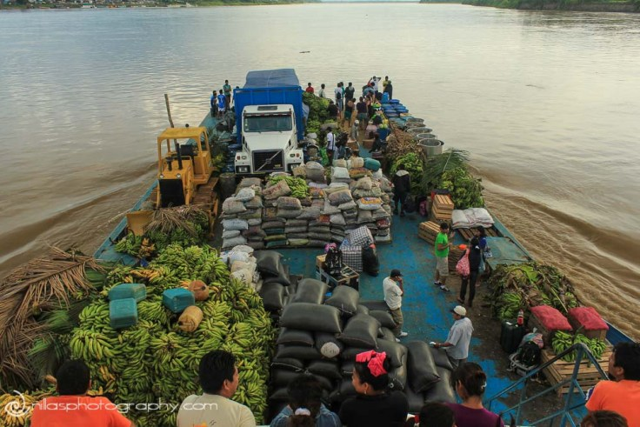
Transport Strategy: Potential modes
Electrification
Reduction in fossil fuel reliance, noise, and emission
Propulsion System Position
Explore over/underwater propulsion for different echelons
Tugged barges
Increase manouvebility and safety for workers
Multifunctional ship
Optimise vehicle usage, and allows low season adaptation.
Hybrid cargo sail boat,
autoevolution.com
Multipurpose barge in Peru
imageearthtravel.com

Slide 10


Data sourcing and modelling
IBGE (Brazil Institute of Geography and Statistics) - Main source of data
Portal of INDE (National Spatial Data Infrastructure) - Interactive maps with layers

Slide 11
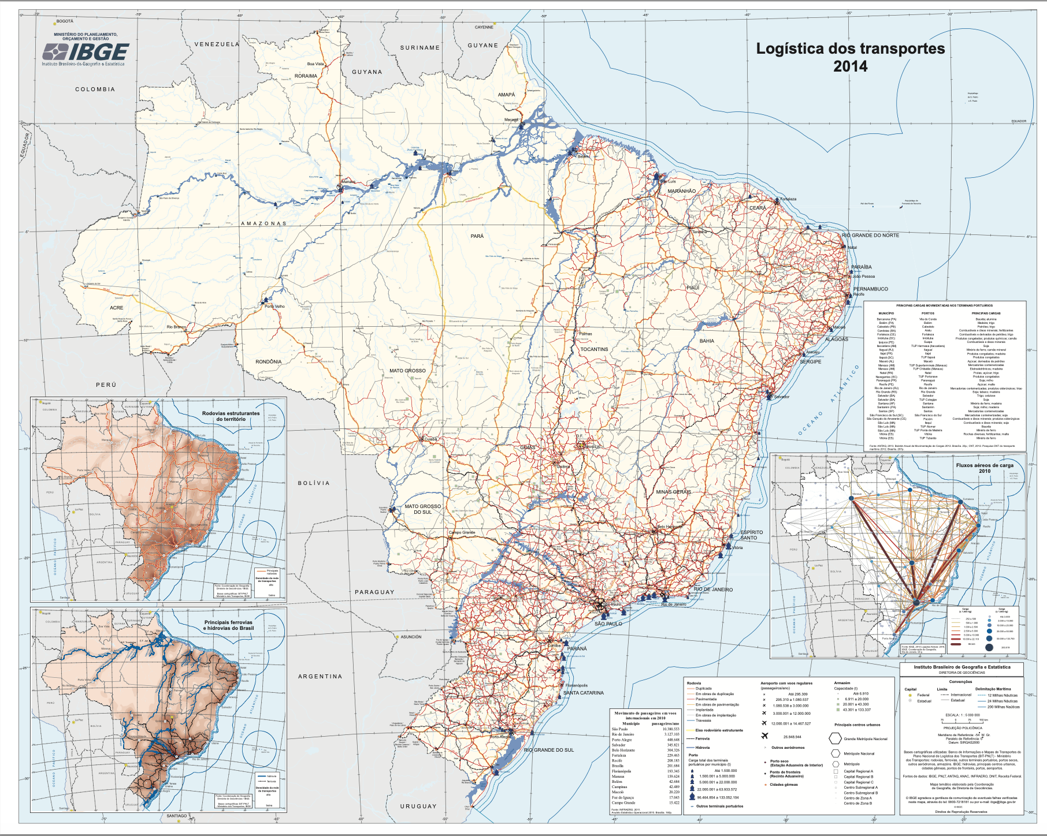
IBGE – Maps
Logistics in Amazon region including:
Ports, Airports, Rivers, Population density, Indigenes zones, Conservation zones, Gas Pipeline, Electric transmission lines
Altimetry in Brazil
Agrarian structure in Amazon region including:
Number of murders per zone, precarious land situation, forms of appropriation of the agricultural land,
Vegetation of Amazon region including:
Location of new starting fire since 2005, nature of vegetation
Climate aggressiveness potential
Occupation of space
Flow of humans and migration inside the country coming to amazon region
Urban network including size of population and complexity of network and flows between two hubs.
Agriculture production
Transport Logistics including:
Cargo transport flow map, railway map, roadway map, waterway map.

Slide 12
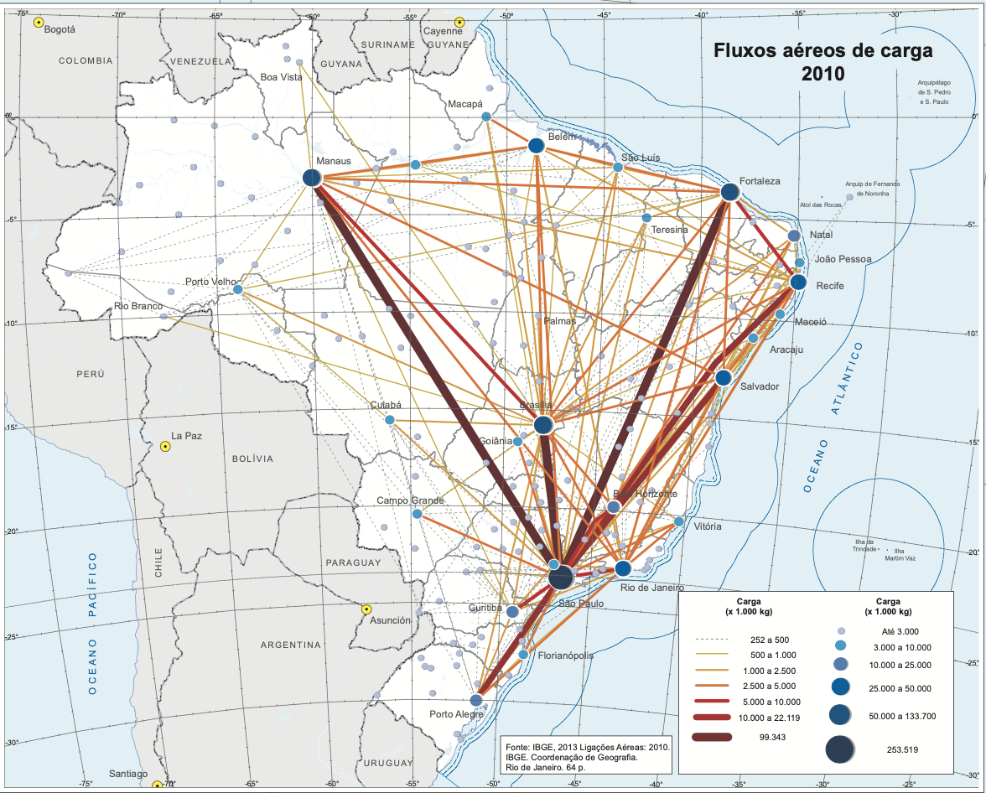
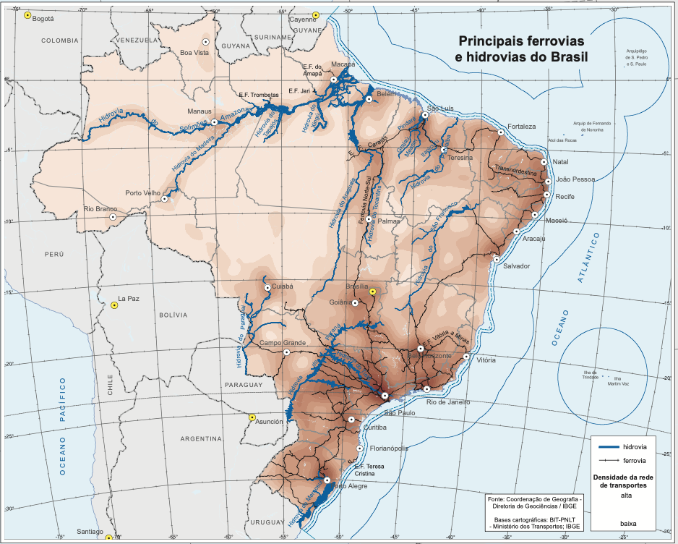
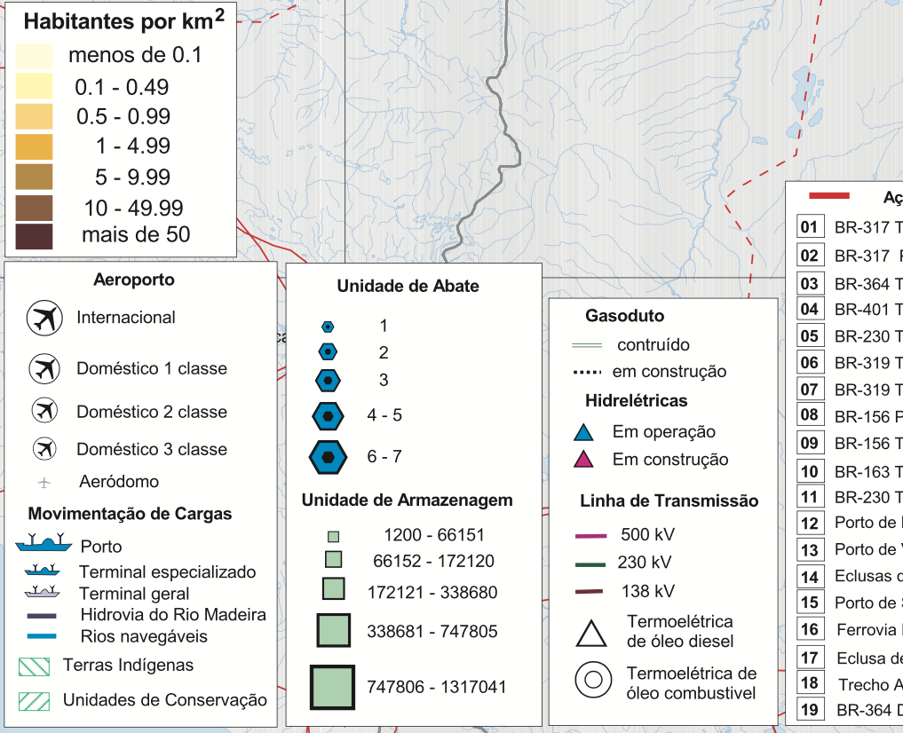
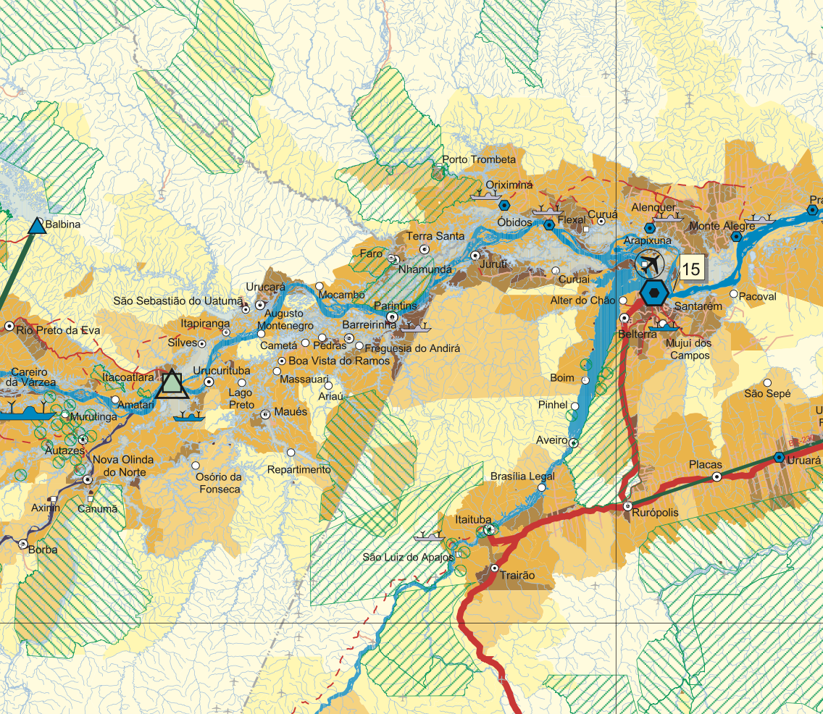
IBGE – Maps
Transport Logistics including:
Cargo transport flow map, railway map, roadway map, waterway map.
Logistics in Amazon region including:
Ports, Airports, Rivers, Population density, Indigenes zones, Conservation zones, Gas Pipeline, Electric transmission lines

Slide 13
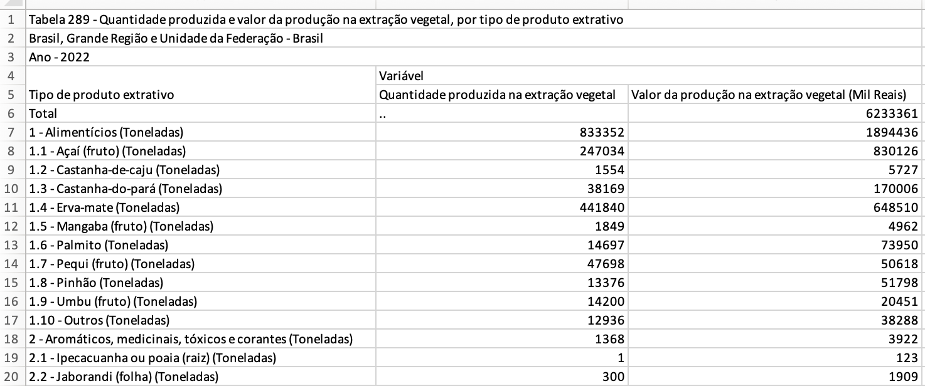
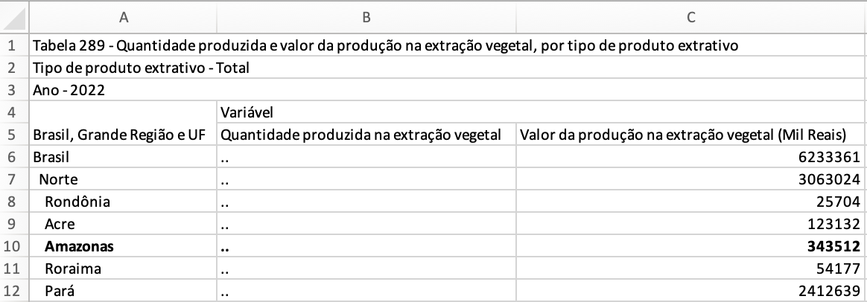
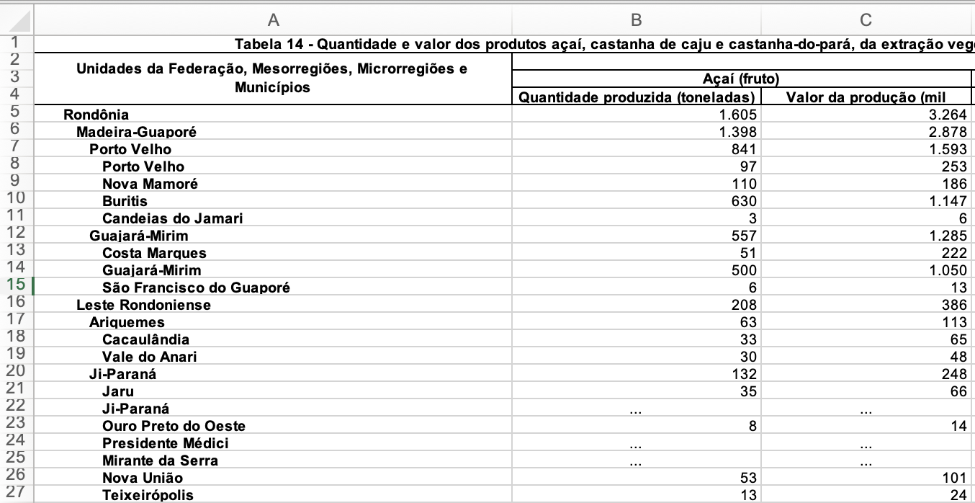
IBGE – Tables
Acai and Brazil nuts:
Table of quantity in 2022 for Brazil
Quantity of goods in Amazon region
Quantity production of Acai and Brazil nuts per region 2016

Slide 14
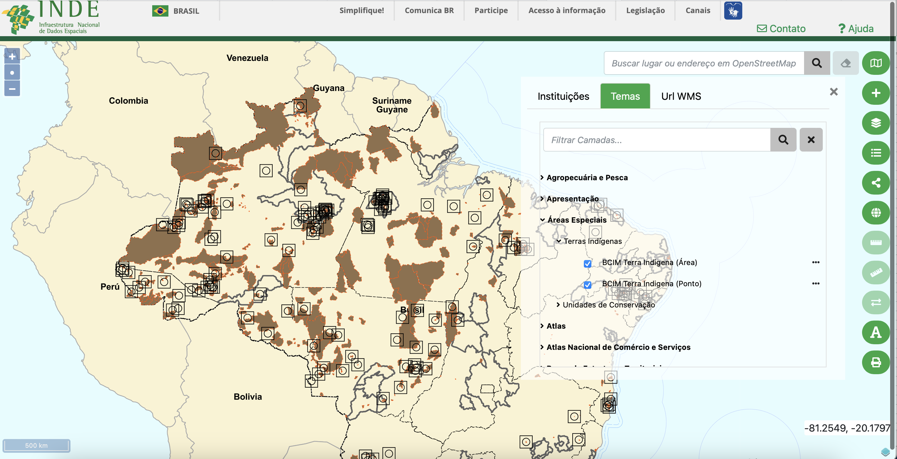
INDE Portal
Interactive map with layers
All in Portuguese
No data on specific products

Slide 15
Project Scope
- Scope: Brazilian Amazon
Assumptions: Use local markets and farms of a certain size as sources.
Modes: Waterways transport only in forest area, Considered rail, road, and Air if only existed facility
Echelons considered: (Forest) --> Local Market/ Farms --> Warehouses --> Factory --> Final destination
Objective: A centralized warehouse with modern facilities and Implement VRP solutions to optimize the transportation routes to improve supply chain efficiency.
Objective Setting and Information Gathering
Data Processing
Assumptions based on constraints
Modelling
Feasibility analysis of the result
Final Outcomes

Slide 16
Project Scope
 | Establishing a Centralized Warehouse | Solving the Vehicle Routing Problem
Benefits | Improved Storage Condition Economies of Scale Standardized Logistics | Optimized Routes Dynamic Adaptability Scalability
Challenges | Location Selection Large Initial Investment Regulatory and Environmental Concerns | Accurate and comprehensive data Requirements Technological Infrastructure Coordination Complexity (multiple stakeholders)
Suggestions | Considering the unique challenges and opportunities in the Amazon region, a combined approach integrating a centralized warehouse with VRP optimization may provide the most comprehensive solution. But: Limited time – Using other proper algorithm like GA

Slide 17
